Slide 1



MEDEX MEDICAL CENTER
PROJECT MEMBERS:
A.NILAFER NISHA(15CSR121)
B.R.NIVEDHINI(15CSR125)
A.PERIYANAYAKI(15CSR132)
PROJECT GUIDE:
Ms.K.Vinu ME.,

Slide 2
PROBLEM STATEMENT
To Book Doctor’s Appointment, People find difficult to call in clinic or personally go to that place.
Patient does not come to know unless he/she goes to the clinic, if the doctor cancels his/her schedule.
A Java Web Application helps to automate and manage patient appointments booking to save precious time of patients as well as doctor.

Slide 3
OBJECTIVES
Automate and manage appointment bookings.
Reduces paper work.
Efficient and reduces time.
Easy operation for the user of the system.
Secured web application in terms of Information retrieval.

Slide 4
SCOPE OF THE SYSTEM
Proposed system consists of three major modules
Patient
Doctor
Medex Admin
SCOPE OF PATIENT MODULE: Login, Register, Patient, Book a Doctor’s Appointment.
SCOPE OF DOCTOR MODULE: Check Appointments, Add Diagnosis Info,
View all Patient Info.
SCOPE OF ADMIN MODULE: Doctor Registration.

Slide 5
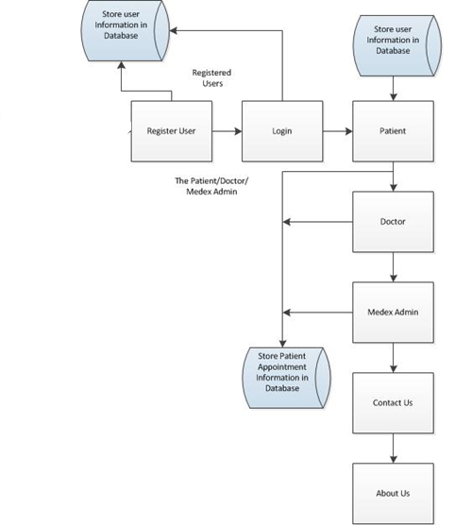
SYSTEM DIAGRAM

Slide 6
TECHNOLOGIES
FRONT END :
Html
CSS
Bootstrap
Javascript
Jquery
Ajax
MIDDLEWARE:
Servlets
BACK END:
MySQL
JDBC(Database Connectivity)
JSP

Slide 7
SYSTEM REQUIREMENTS
MODULES
Patient
Doctor
Admin

Slide 8
PATIENT MODULE:
Patient - Registration page
Patient - Login Page
Patient - Logged in page
Book Appointment Tab
View Appointments
Cancelation Appointment

Slide 9
DOCTOR MODULE:
Check Appointments
Add Diagnosis Info
View All Appointment

Slide 10
MEDEX ADMIN MODULE:
Doctor Registration
ABOUT US:
About Us Tab
CONTACT US:
Contact Us Tab

Slide 11
FUTURE WORKS
Possible to upgrade the system because of the emerging technologies.
Security can be improved using emerging technologies.
Additional modules can be added.

Slide 12
CONCLUSION
This Java Web Application automates and manages patient appointments booking.
Saves patient’s and doctor’s time .
Efficient, secured and user friendly.

Slide 13
THANK YOU

